Slide 1
ANALYSIS ON SALES DATA FROM DIFFERENT SUPER MARKETS
By:
Mayank Raj

Slide 2
Problem Statement
What is the Total Sell in different cities?
Total Sell of different products.
Total Sell among different Genders of People.
What is the Total Sell in different Branches?
Total Sells for different Types of Customers?
Total Selling at different Branch of different Products.
Different Modes of Payment Type for Total Sell.
What is the Maximum Unit Price of the Products in different cities?

Slide 3
Problem Statement Continues…
Total Selling of products to different types of Customers? Member or Non-Member.
Gross Income from different Products from different types of Customers.
What are ratings for different products?
Count the Number of Invoice Id's at different Branches.
Source:
https://www.kaggle.com/aungpyaeap/supermarket-sales

Slide 4
Executive Summary
After doing the Analysis of Sales Data from different Super Markets from different region we can address following questions:
Which city has highest and lowest sales?
Which product has more demand or which product selling is highest compared to other and which product selling is lowest?
Total Selling of product in different branches.
Which type of Customer purchase more products? Is it Normal Customer or those Customers who are the members of Super Market.
What are the payment types of the Customers?
What is the rating of different products given by customers?
Link to Video : Video or
https://youtu.be/1pqDdNW33IE

Slide 5
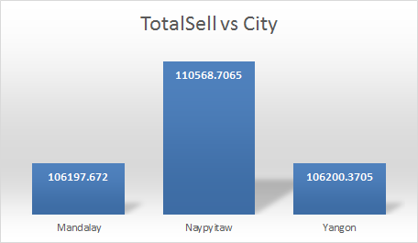
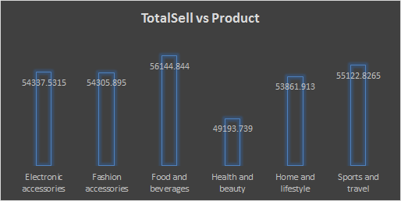
Total Sales in different Cities and of different Products
Naypyitaw has highest sales while Mandalay has lowest sales.
Food & Beverages has highest sales while Health & Beauty products has lowest sales.

Slide 6
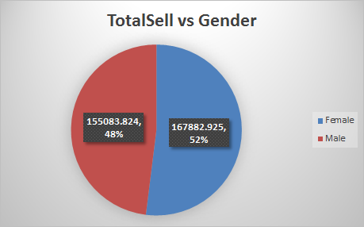
Total Sales vs Gender
We can analyse that 52% of the total customer are Females and 48% Male customers.

Slide 7
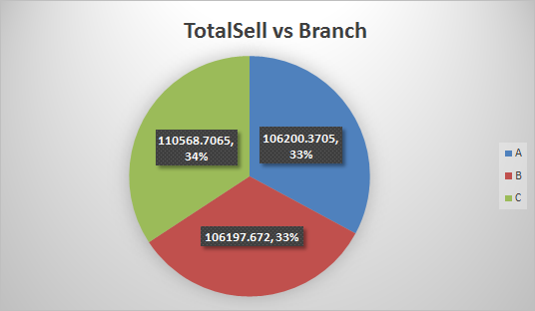
Total Sales vs Branch
We can analyse that Branch A & B has 33% of the total sales while Branch C has 34% of the total Sales .

Slide 8
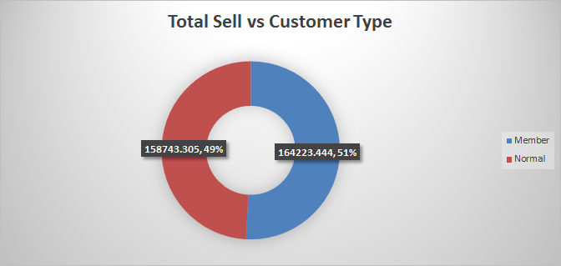
Total Sales vs Customer Type
Members for customers using member card and Normal for without member card. We can analyse that 51% of the customers are Members while 49% of the customers are Normal Customers.

Slide 9
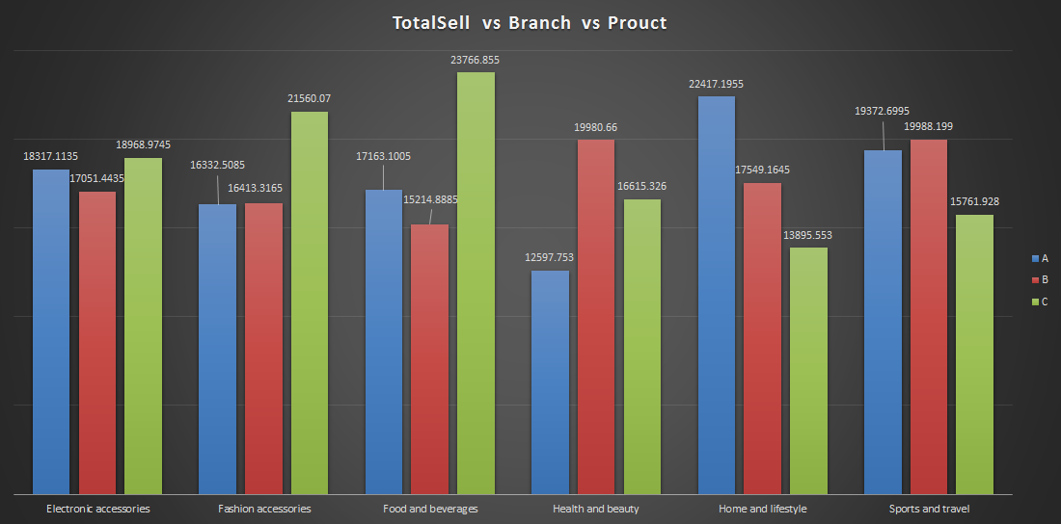
Total Sales of Products at different Branches

Slide 10
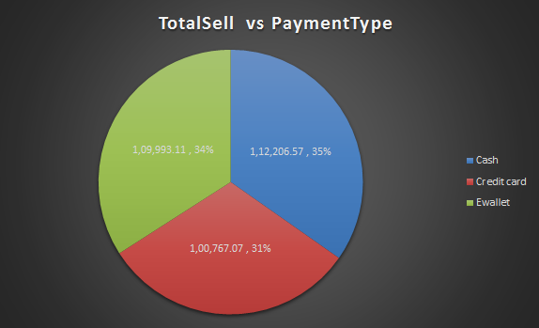
Payment Received
We can analyse that 35% of the Payment has been received by cash mode, while 34% of the Payment has been received by Ewallet and remaining 31% by Credit card.

Slide 11
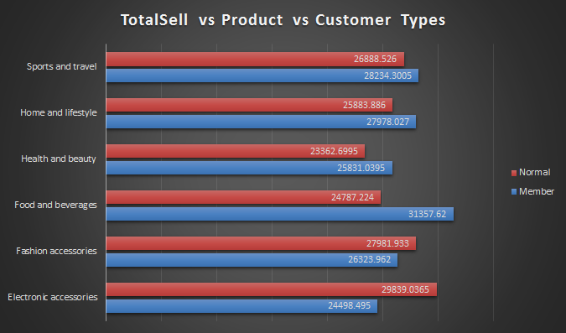
Types of Customers vs Products

Slide 12
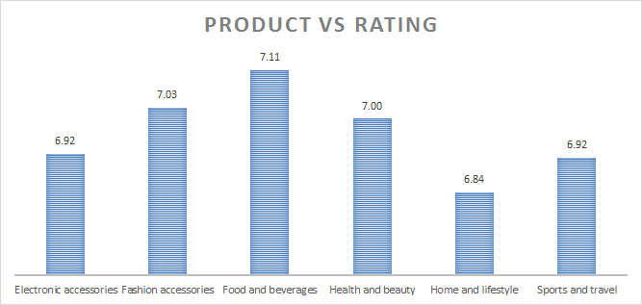
Products Rating
We can analyse that Food & Beverages has been rated highest while Home & Lifestyle Products has the lowest ratings.

Slide 13
Conclusion
This analysis is done on the data collected from supermarkets located at 3 different cities for 3 months.
We can conclude that Naypyitaw has the highest sales compared to other cities. So C branch has the highest sales as it is located in Naypyitaw.
Highest sales was from the Food & Beverages category.
We have more Female customers w.r.t Male customers.
We have received most of the payment in the form of cash.
Highest rated product was Food & Beverages.
Total sales for Food & Beverages is highest for members and Electronic accessories for Non Members.

Slide 14
Next Steps
Try to identify issues why there are less selling of products in other cities like Mandalay.
Even we have more number of Female customers still Health and Beauty products selling is least.
Approximately 50% of customers are not members. We should come up with some offers for customers so that we can expect increase in number of members.
Many Products has been rated below 7. Identify the cause and try to increase quality of the product in order to receive better ratings.

Slide 15
THANK YOU

